Slide 1

Basic presentation

Slide 2
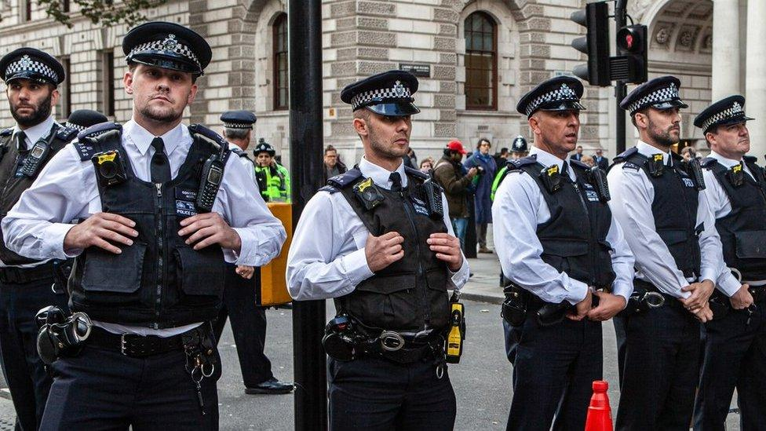
Crime Data Analysis of West Midlands Street Crime (October 2024)

Slide 3
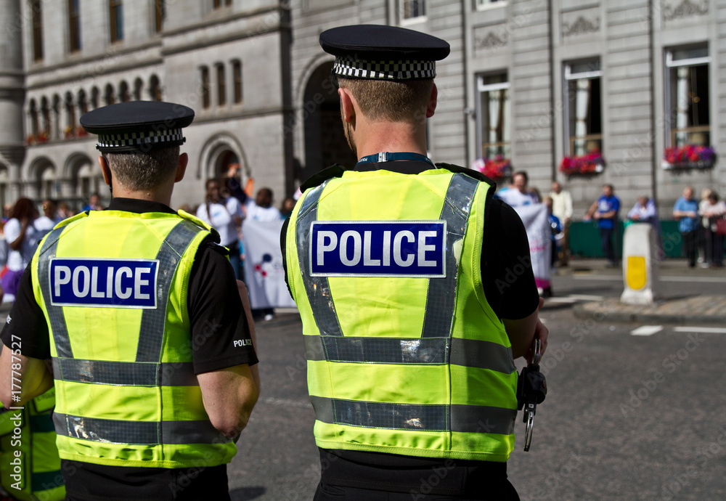
PROBLEM STATEMENT & OBJECTIVES
PROBLEM STATEMENT
LARGE DATASETS ARE DIFFICULT TO INTERPRET MANUALLY.
CRIME PATTERNS ARE NOT IMMEDIATELY OBVIOUS.
OBJECTIVES
CLEAN THE DATASET.
PERFORM EXPLORATORY DATA ANALYSIS.
CREATE VISUALIZATIONS.
BUILD A STREAMLIT DASHBOARD.
DRAW MEANINGFUL CONCLUSIONS.

Slide 4


Dataset & Tools Dataset: - West Midlands Street Crime Dataset - October 2024 - 28,444 rows - 11 columns Key Variables - Crime Type - Location - LSOA Name - Longitude - Latitude - Last Outcome Category Tools Used - Python - Pandas - NumPy - Matplotlib - Seaborn - Jupyter Notebook - Streamlit - GitHub

Slide 5

Data Cleaning
Checked missing values
Removed Context column
Replaced missing outcomes with "Unknown"
Removed duplicates
Checked data types
Converted Month to datetime
Renamed columns
Created Year and Month_Number
Detected outliers
Saved cleaned dataset

Slide 6

Exploratory Data Analysis
Analysis Questions:
Most common crime types
Locations with most crimes
Highest crime LSOAs
LSOAs with the greatest variety of crime
Charts Used
Bar charts
Horizontal bar charts

Slide 7
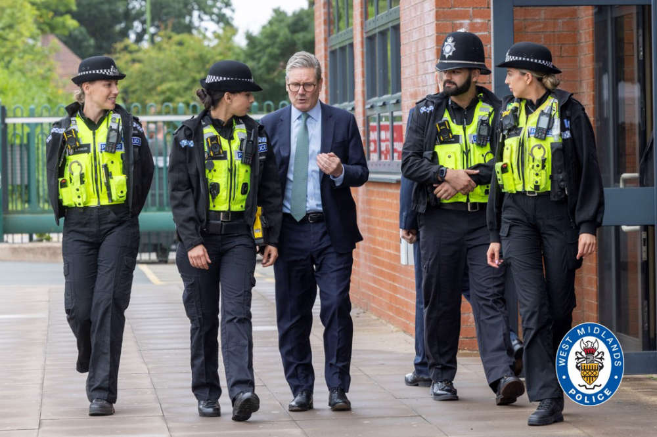
Additional Analysis
Analysis Questions
Crime type vs police outcome
Crime type percentages
Most common crime outcomes
Crime type vs outcome relationship
Crime types in top 10 LSOAs
Crime outcomes in top 10 LSOAs
Charts Used
Pie Chart
Heatmap
Stacked Bar Charts

Slide 8
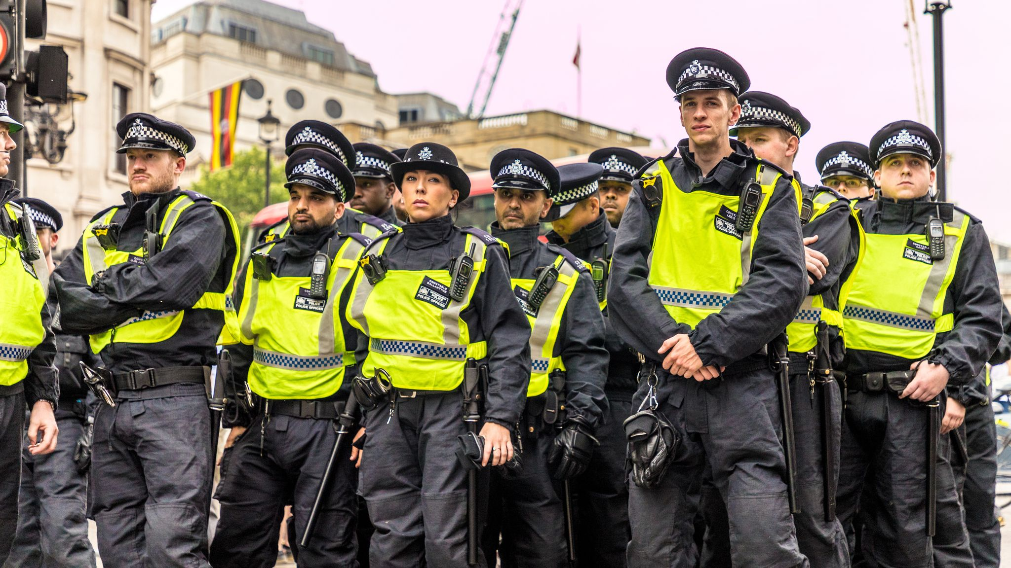

Visualizations
Visualizations Created
Bar Chart
Horizontal Bar Chart
Pie Chart
Heatmap
Stacked Bar Chart
Box Plot
Purpose
Compare frequencies
Show percentages
Identify relationships
Detect outliers

Slide 9


Key Findings
Violence and sexual offences were the most common crimes.
Crime was concentrated in a few neighbourhoods.
Some LSOAs experienced a wider variety of crime.
Crime types showed different outcome patterns.
Some police outcomes occurred much more frequently than others.

Slide 10
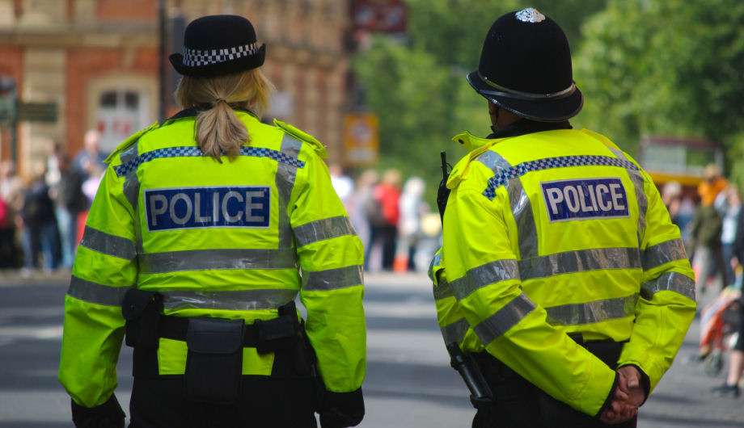
Recommendations
Recommendations
Increase patrols in high-crime areas
Focus prevention on common crimes
Monitor neighbourhoods regularly
Continue analysing crime trends

Slide 11

CONCLUSION

